Slide 1
Classification
By Dr. Supriya Chakraborty

Slide 2
What is Classification?
Classification can be performed on structured or unstructured data. Classification is a technique where we categorize data into a given number of classes. The main goal of a classification problem is to identify the category/class to which a new data will fall under.

Slide 3
Terminology
Classifier: An algorithm that maps the input data to a specific category.
Classification model: A classification model tries to draw some conclusion from the input values given for training. It will predict the class labels/categories for the new data.
Feature: A feature is an individual measurable property of a phenomenon being observed.
Binary Classification: Classification task with two possible outcomes. Eg: Gender classification (Male / Female)
Multi-class classification: Classification with more than two classes. In multi class classification each sample is assigned to one and only one target label. Eg: An animal can be cat or dog but not both at the same time
Multi-label classification: Classification task where each sample is mapped to a set of target labels (more than one class). Eg: A news article can be about sports, a person, and location at the same time.

Slide 4
Steps involved in building a classification mode
Initialize the classifier to be used.
Train the classifier: All classifiers in scikit-learn uses a fit(X, y) method to fit the model(training) for the given train data X and train label y.
Predict the target: Given an unlabeled observation X, the predict(X) returns the predicted label y.
Evaluate the classifier model

Slide 5
Types Classification Algorithms
1. Logistic regression
2. Naive Bayes
3. K-Nearest Neighbors
4.Support Vector Machine
5. Decision Tree

Slide 6
Logistic Regression
Logistic regression is a classification algorithm used to assign observations to a discrete set of classes. Some of the examples of classification problems are Email spam or not spam, Online transactions Fraud or not Fraud, Tumor Malignant or Benign. Logistic regression transforms its output using the logistic sigmoid function to return a probability value.

Slide 7
What are the types of logistic regression?
Binary (eg. Tumor Malignant or Benign)
Multi-linear functions failsClass (eg. Cats, dogs or Sheep's)

Slide 8
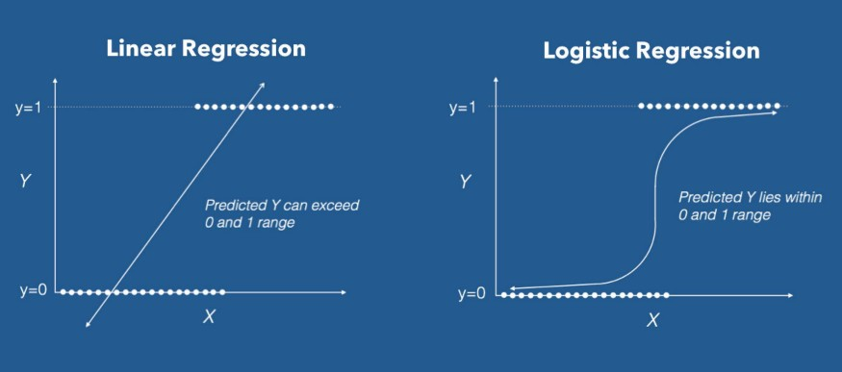
Function of Logistic Regression
a Logistic Regression a Linear Regression model but the Logistic Regression uses a more complex cost function, this cost function can be defined as the ‘Sigmoid function’

Slide 9

Hypothesis of Logistic Regression
The hypothesis of logistic regression tends it to limit the cost function between 0 and 1. Therefore linear functions fail to represent it as it can have a value greater than 1 or less than 0 which is not possible as per the hypothesis of logistic regression.

Slide 10
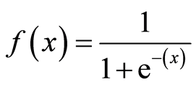
What is the Sigmoid Function?
In order to map predicted values to probabilities, we use the Sigmoid function. The function maps any real value into another value between 0 and 1. In machine learning, we use sigmoid to map predictions to probabilities.
Equation of Sigmoid Function

Slide 11

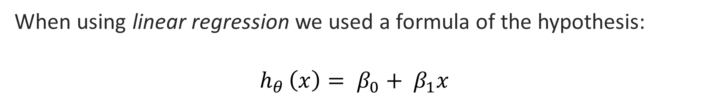
Hypothesis Representation
When using linear regression we used a formula of the hypothesis:
$$h_{θ }\left(x\right)= β_{0}+ β_{1}x$$
For logistic regression, modify the above equation as below:
$$σ\left(Z\right)=σ(β_{0}+ β_{1}X)$$

Slide 12
Linear vs. Logistic Regression
Similarities
Difference
Linear Regression and Logistic Regression both are supervised Machine Learning algorithms.
Linear Regression and Logistic Regression, both the models are parametric regression i.e. both the models use linear equations for predictions
Linear Regression is used to handle regression problems whereas Logistic regression is used to handle the classification problems.
Linear regression provides a continuous output but Logistic regression provides discreet output.
The purpose of Linear Regression is to find the best-fitted line while Logistic regression is one step ahead and fitting the line values to the sigmoid curve.
The method for calculating loss function in linear regression is the mean squared error whereas for logistic regression it is maximum likelihood estimation.

Slide 13

Hypothesis lies between 0 and 1:
Therefore, $Z=β_{0}+ β_{1}X and h_{θ }\left(x\right)=Sigmoid (Z)$
i.e. $h_{θ }\left(x\right)= \frac{1}{1+ e^{−(β_{0}+ β_{1}X)}}$

Slide 14
Decision Boundary
The threshold as 0.5, if the prediction function returned a value of 0.7 then we would classify this observation as Class 1(DOG). If our prediction returned a value of 0.2 then we would classify the observation as Class 2(CAT).

Slide 15

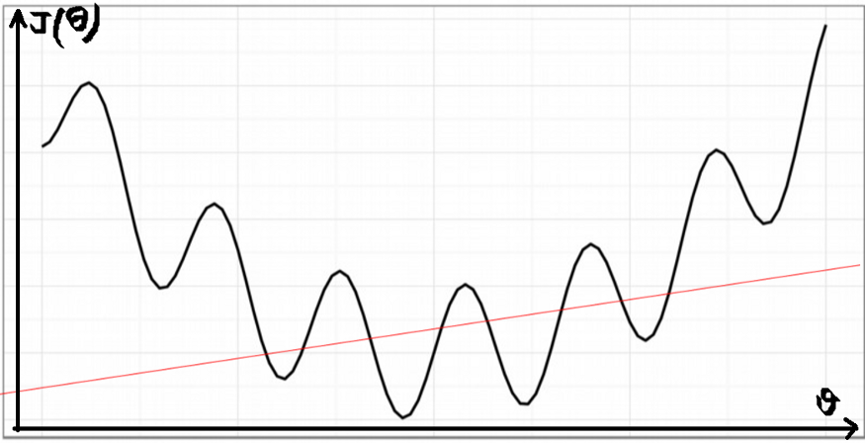
Cost Function
If we apply the following cost function of the linear regression:
if we try to use the cost function of the linear regression in ‘Logistic Regression’ then it would be of no use as it would end up being a non-convex function with many local minimums, in which it would be very difficult to minimize the cost value and find the global minimum.

Slide 16
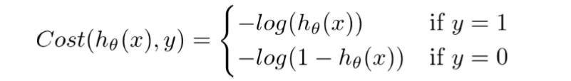
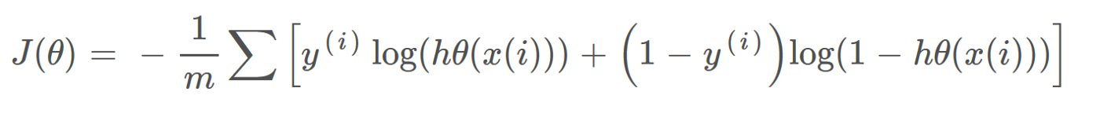
For logistic regression, the Cost function is defined as:
The above two functions can be compressed into a single function i.e.

Slide 17

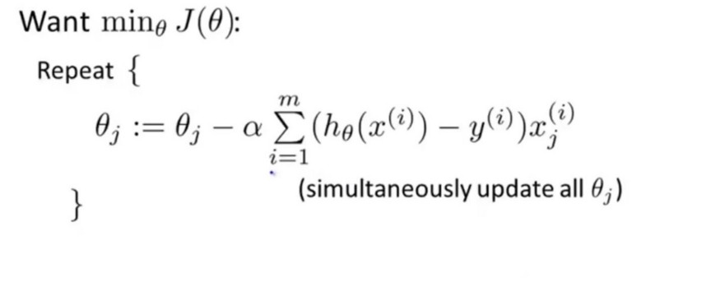
Reduce the cost using Gradient Descent

Slide 18
Thank you we will further cover Naïve Baye’s and Decision Tree

